Slide 1
Charged Particle Trajectory Reconstruction Algorithms for Cathode Strip Chambers of the CMS Experiment Vladimir Palichik, Nikolay Voytishin JINR(Dubna)
ROLCG-2018
Cluj
2018-10-19

Slide 2
Outline
Cathode-Strip Chamber (CSC) detector of the CMS experiment;
Segment reconstruction in CSCs;
Precise coordinate reconstruction in CSCs:
Simple two maxima delimitation;
Wavelet-based algorithm for multiple maxima.
<number>

Slide 3
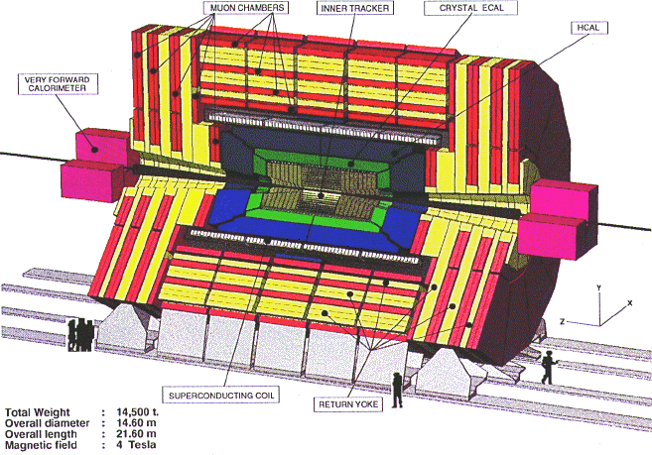
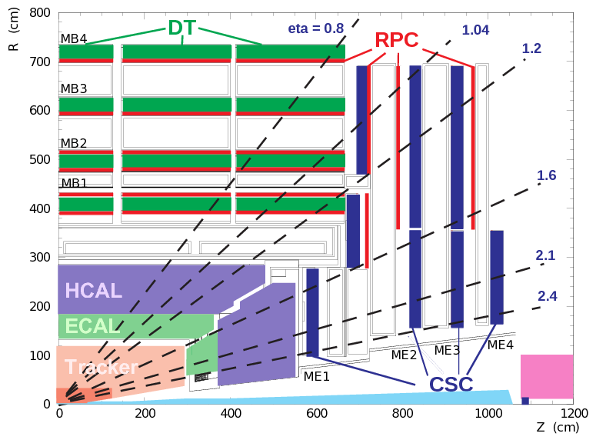
Compact Muon Solenoid Detector
Cathode Strip Chambers (CSC)
<number>

Slide 4
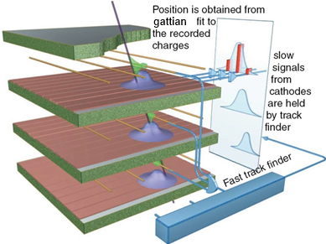
CSC Local Reconstruction
<number>

Slide 5
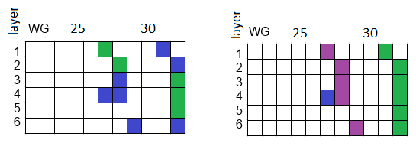
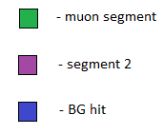
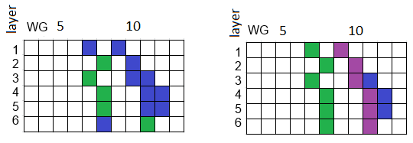
Event Example for wire coordinate segment
ST algo (standard) Target output
Collisions 2012 Run 198210 ME1/3 n_ev 1543
Collisions 2012 Run 198210 ME1/3 n_ev 12044
<number>

Slide 6
RU(RoadUsage) Algorithm main ideas
Taking into account the IP while choosing the base hits in terms of WG for the future segment;
Base Road for RecHit association:
A straight line is traced through the base hits
In the road formed along this line new hits from the inner layers are added to the segment
Phi & tuned thresholds for each CSC station;
If there are enough unused RecHits left the segment reconstruction is run again with the IP check turned off in order to reconstruct segments that correspond to displaced muons.
Implemented into the official CMS software package in July,2016
Starting 2017 it became the DEFAULT algorithm for reconstruction in CSC
<number>

Slide 7
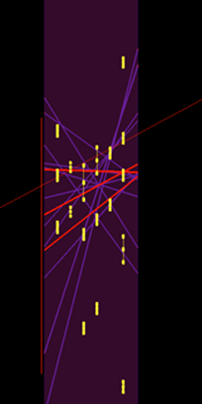
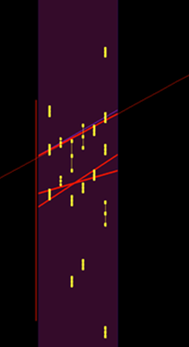
High multiplicity example - 84 RecHits in Chamber
Muon trajectory
Standard
15 segments
New
4 segments
<number>

Slide 8
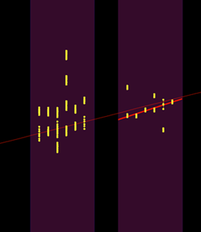
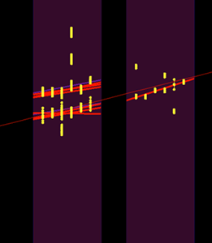
High multiplicity example - 44 RecHits in ME21
Muon trajectory
Standard
0 segments
New
8 segments
<number>
Collisions2015 256630:22:28500814

Slide 9
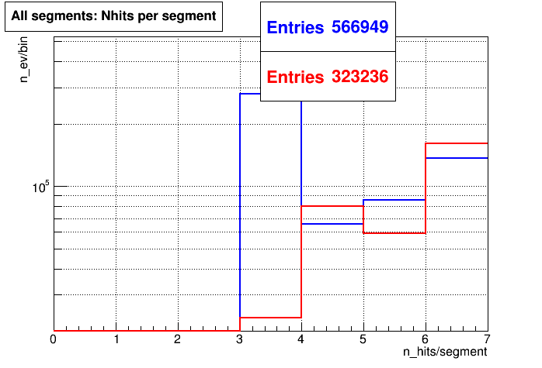
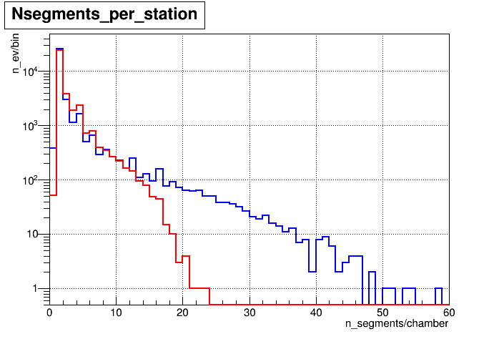
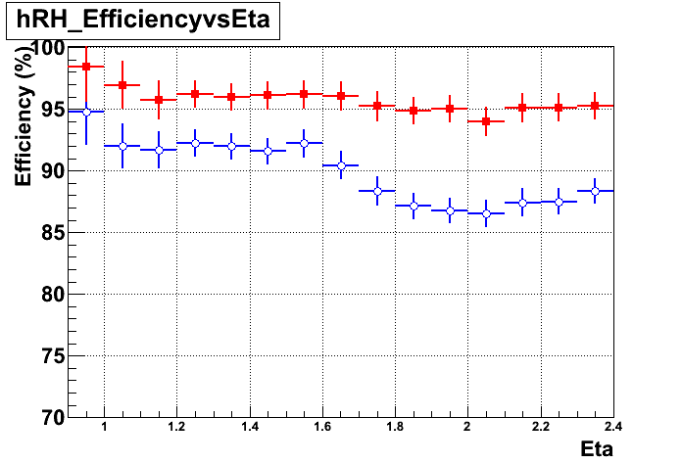
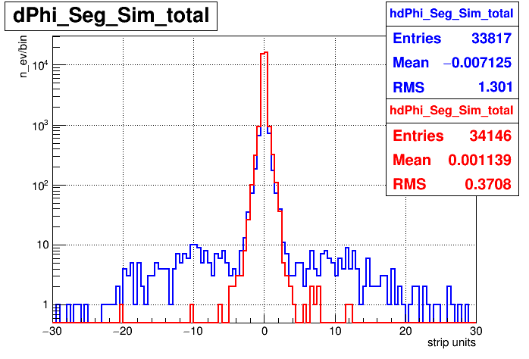
Two algorithms’ comparison
<number>
Segment multiplicity
Overall segment size
HaloMu
dPhi between muon segment and MC muon trajectory
DisplacedMu SUSY
Efficiency
Displaced Mu
blue – Standard(ST) algorithm; red – NEW(RU) algorithm.
Notes:
<number>

Slide 10
RU algorithm used for GEM detectors in CMS
<number>

Slide 11
Local Segment Reconstruction Summary
The new algorithm shows a better performance for all types of CMS data;
The RU algorithm was implemented in the official CMS software in 2016;
It was adopted for segment reconstruction in the GEM detectors of the CMS muon system;
It became the default segment reconstruction algorithm starting with 2017 data-tacking period of the LHC;
The optimization and code support is a continuously ongoing task for us;
<number>

Slide 12
Reconstruction of local coordinate on a particular layer
Muon trajectory
Big strip error RHs
> 25% of strip width
~ 2% of strip width
Regular strip charge distribution
Abnormal strip charge distributions
CMS Collisions 2015 event display
<number>
Cases that need improvement

Slide 13
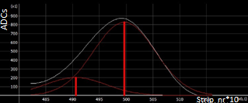
Simple two maxima delimitation
> 25% of strip width
16
16
14
14
<number>
Strip ADC’s
10
106
119
374
178
12

Slide 14
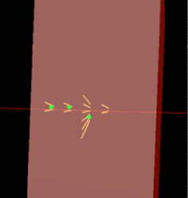
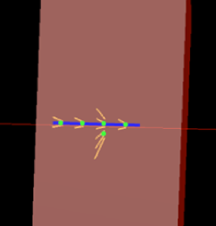
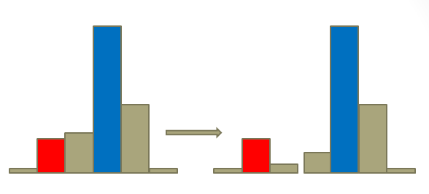
Event example with two maxima in layer 3
L1 L2 L3 L4
L1 L2 L3 L4
14.37 14.32 16.20 14.04
14.37 14.32 14.16 14.04
16.36
= 125.7
= 1.01
<number>

Slide 15
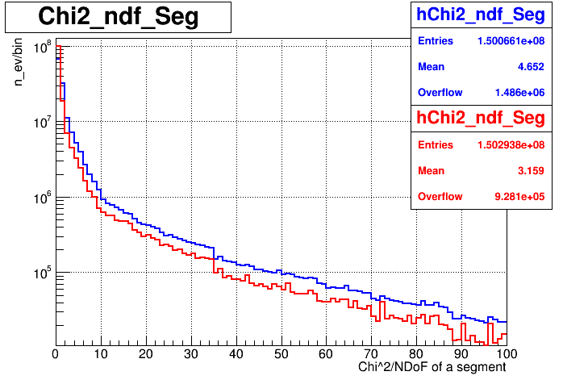
/NDoF of a segment
<number>
BLUE – standard RH Builder; RED – abnormal strip distribution division

Slide 16
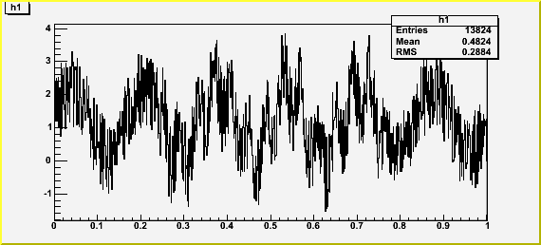
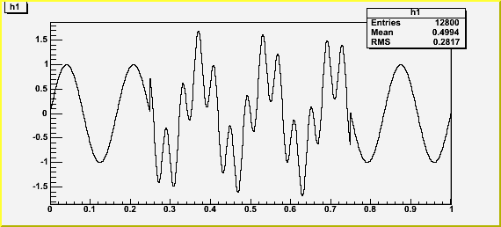
Wavelet analysis for overlapped signals
Wavelet filter
A – Gaussian amplitude, x₀ and y₀ - centers of Gaussian
Usage for overlapped signal separation in HEP experiments
high precision of extremum recognition;
scalable number of extrema.
numerical methods needed;
slow calculation for > 3 extrema.
<number>

Slide 17
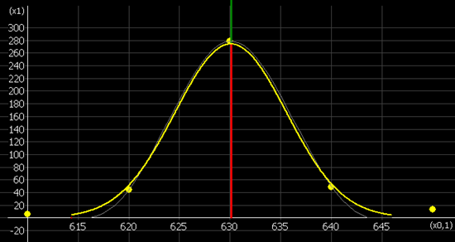
Wavelet-based algorithm for multiple maxima
Nothing to improve here
~ 2% of strip width
Regular strip charge distribution
Yellow – initial signal distribution;
Red – coordinate reconstructed by the new algorithm;
Green line – simulated coordinate;
Blue line – coordinate reconstructed by the standard algorithm.
<number>

Slide 18
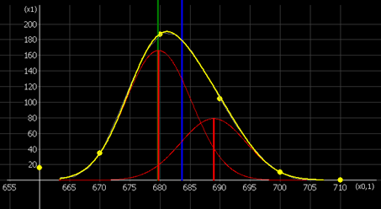
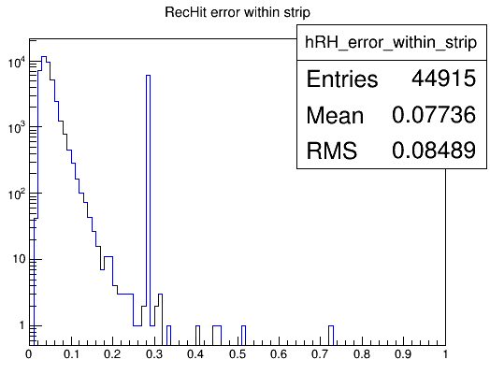
Reconstruction of two overlapping signals
> 25% of strip width
Abnormal strip charge distributions
$σ_{bad}=\frac{1}{\sqrt{12}}$
Yellow – initial signal distribution;
Red gaussians and their centers - predicted overlapped coordinates reconstructed by the NEW algorithm;
Green line – simulated coordinate;
Blue line – coordinate reconstructed by the STANDARD algorithm.
If >25%
the coordinate is calculated using Center Of Gravity (COG) algorithm
<number>

Slide 19
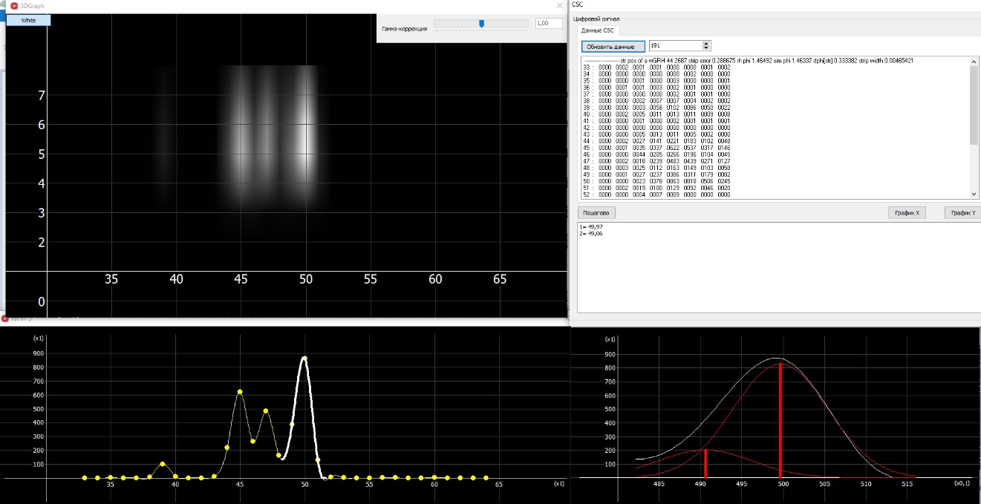
Universal tool for overlapping signal recognition
Time Bins
Input data – ADCs on strips
Visualization of the input data
ADCs
Strip_nr
ADCs
Search area selection
Result display
Strip_nr
Strip_nr*10
Remark. This tool can be used for visualization and signal delimitation for any detectors that use clustered charge distribution readout.
<number>

Slide 20
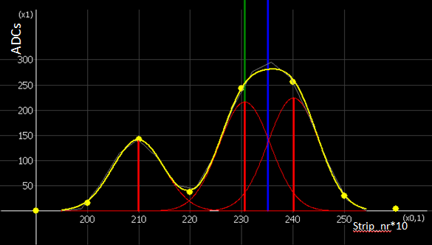
Three overlapped signals recognition
ADCs
Strip_nr*10
Yellow – initial signal distribution;
Red gaussians and their centers - overlapped coordinates reconstructed by the NEW algorithm;
Green line – simulated coordinate;
Blue line – coordinate reconstructed by the STANDARD algorithm.
<number>

Slide 21
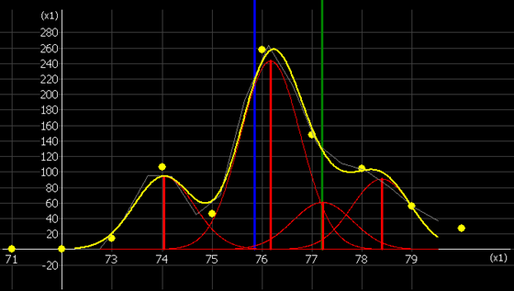
Reconstruction of four overlapped signals
Yellow – initial signal distribution;
Red gaussians and their centers - overlapped coordinates reconstructed by the NEW algorithm;
Green line – simulated coordinate;
Blue line – coordinate reconstructed by the STANDARD algorithm.
<number>

Slide 22
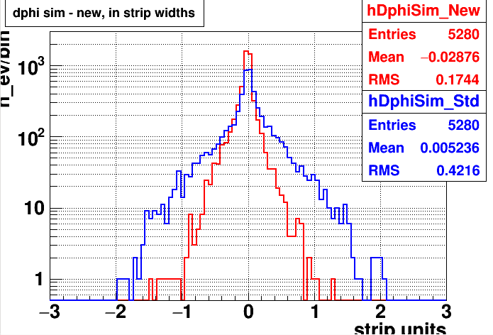
Two algorithms comparison on higher statistics
<number>
BLUE – Standard algorithm; RED – NEW algorithm.

Slide 23
Local Coordinate Reconstruction Status and Plans
Status:
Simple two maxima delimitation developed;
It finds “hidden” signal coordinate resulting in a valuable improvement in the quality of segments;
A more “sophisticated” method based on wavelet method was developed;
This tool can be used for any detector that works with cluster-shape charge distributions;
The new approach reconstructs the strip coordinate ~2.5 times closer to the MC muon in comparison with the standard approach;
It is time consuming, especially for >2 maxima delimitation (tested only on PC);
Plans
Simple two maxima delimitation implementation into the official CMS software is scheduled for the beginning of next year;
Run wavelet-based algorithm inside the CMSSW framework to estimate the actual time consumption;
Apply discrete-wavelets instead of continuous ones in order to decrease the time consumption.
<number>

Slide 24
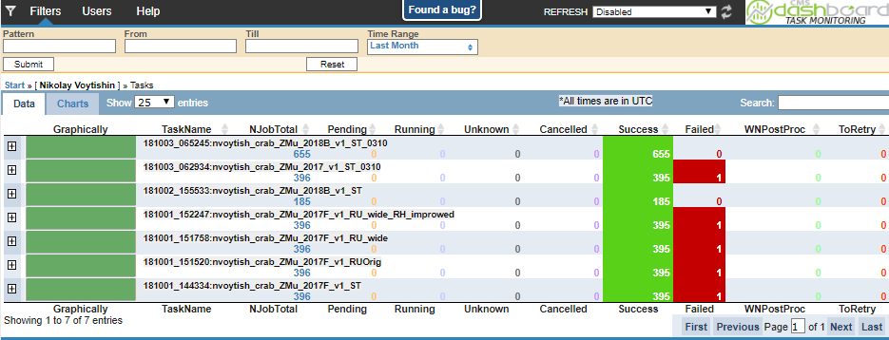
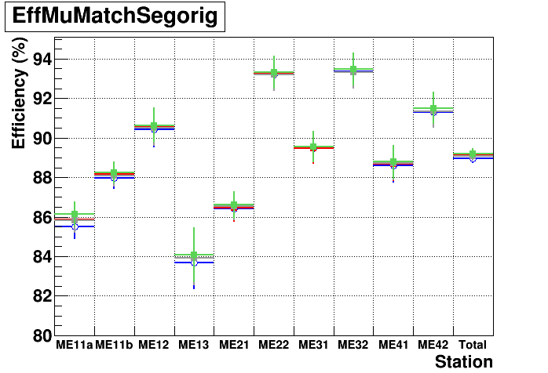
WLCG made all these possible
While developing new algorithms and optimizing them:
> 100 000 jobs were launched;
~15 000 000 000 events processed.
<number>

Slide 25
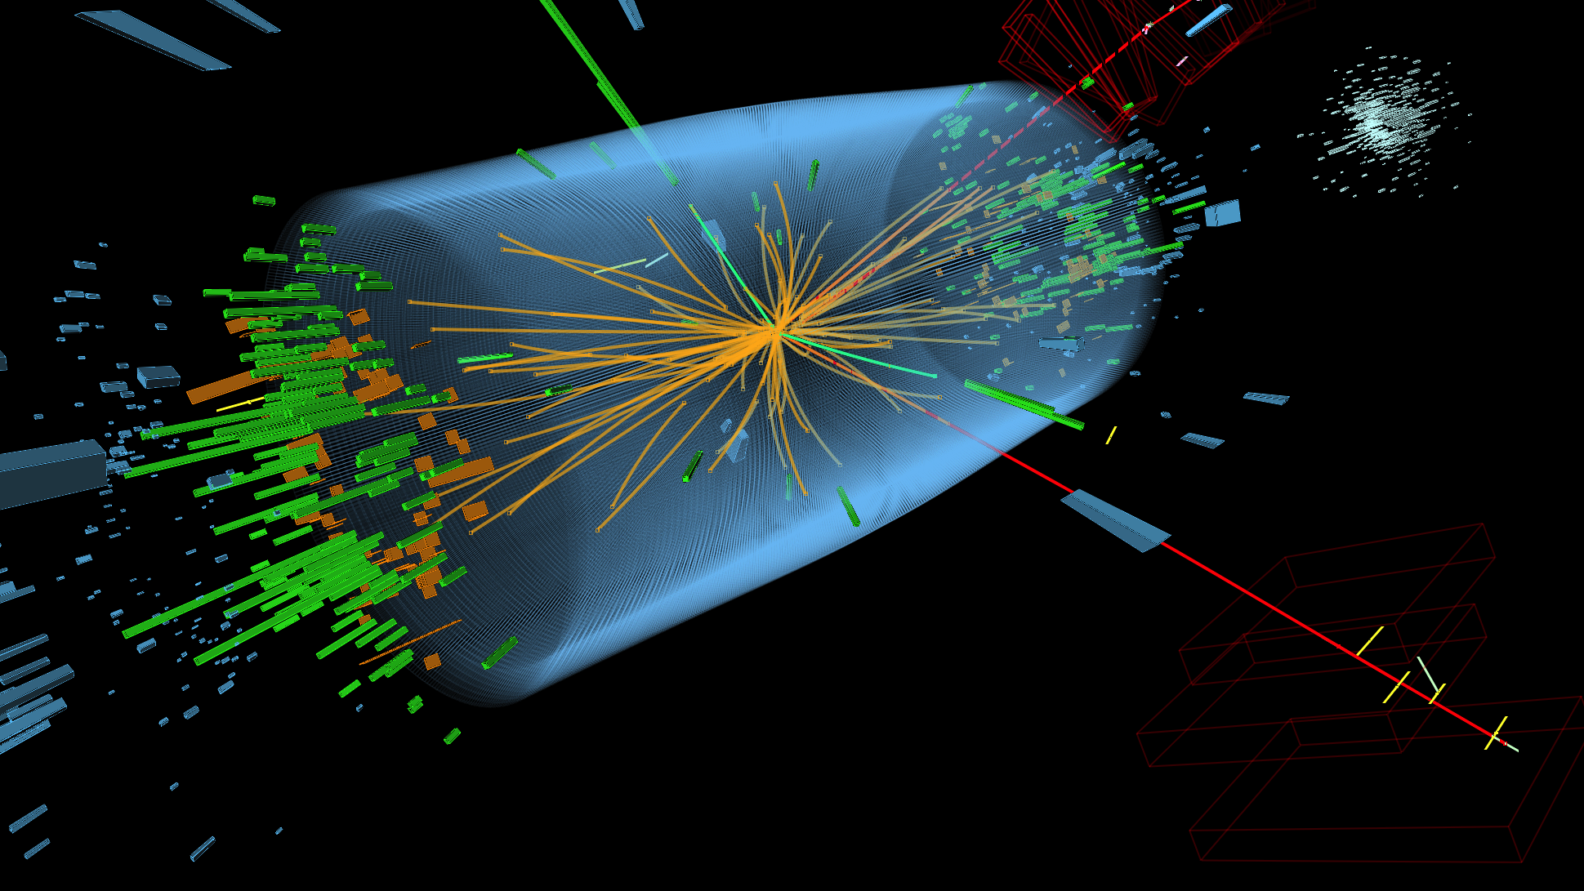
Thank you for your attention!!!

Slide 26
Back up slides
<number>

Slide 27
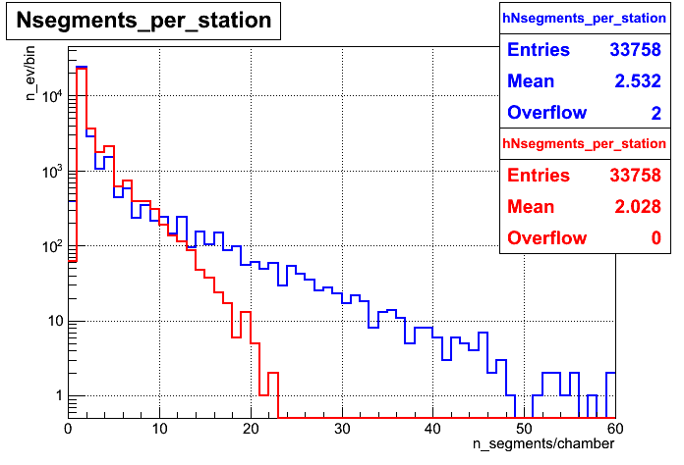
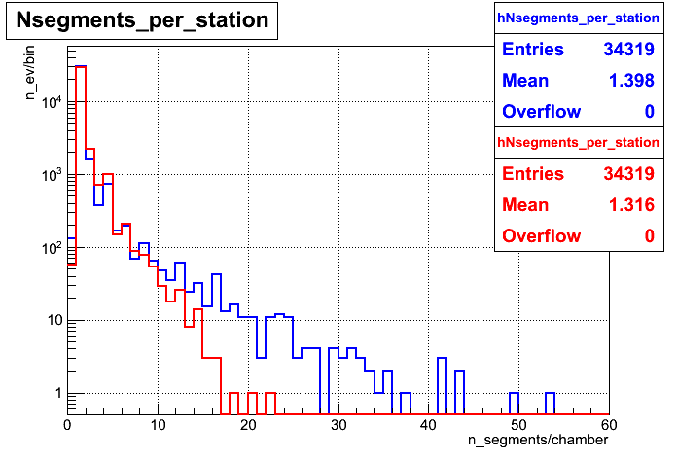
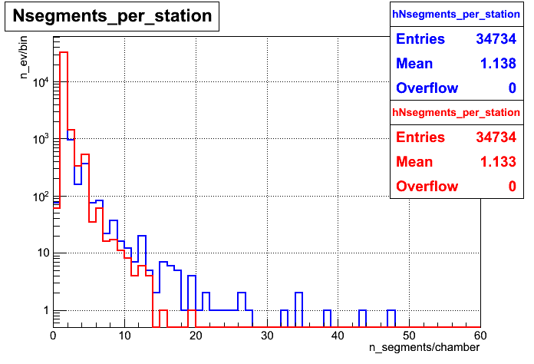
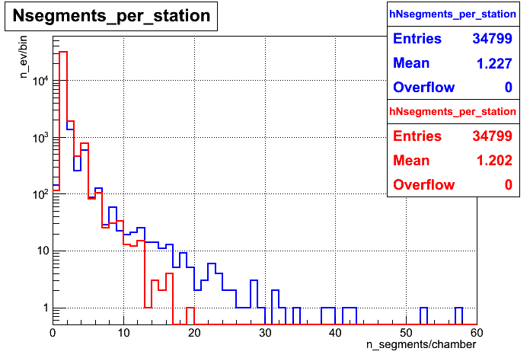
Segment multiplicity per station
1000 GeV
100 GeV
10 GeV
ZMM+PU(25ns)
<number>
blue – ST algorithm; red – RU algorithm.

Slide 28
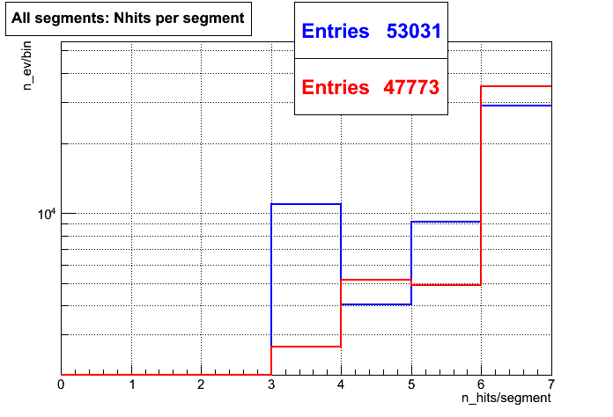
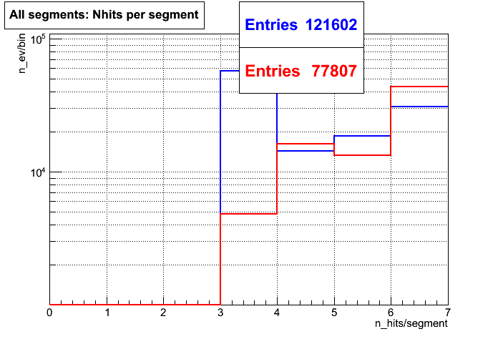
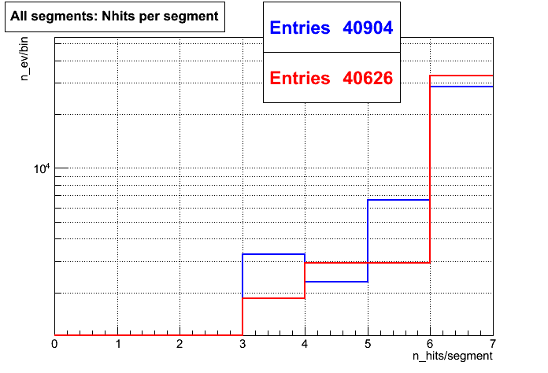
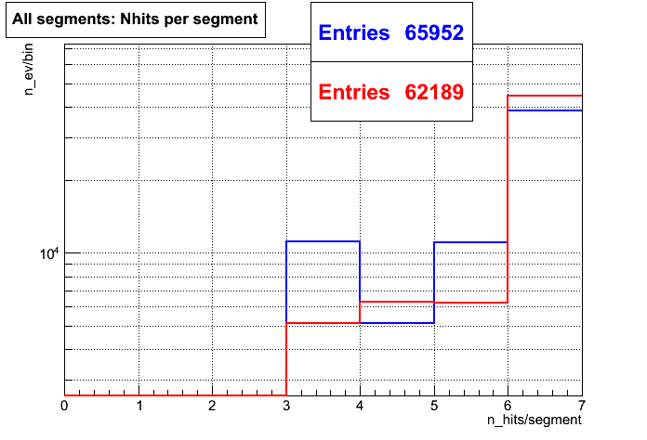
Number of RecHits in all reconstructed segments
<number>
100 GeV
1000 GeV
blue – ST algorithm; red – RU algorithm.
10 GeV
ZMM+PU(25ns)

Slide 29
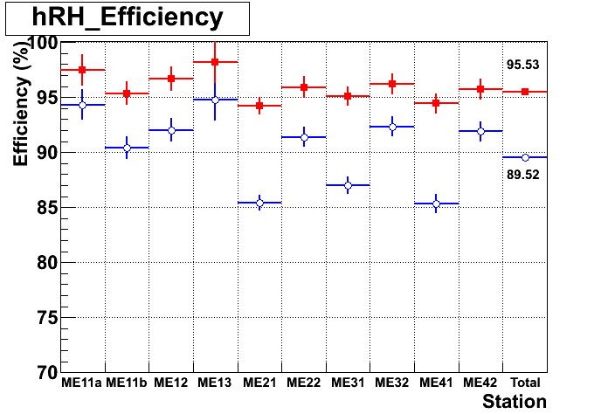
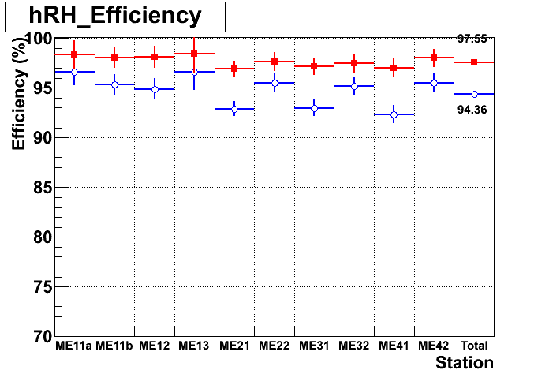
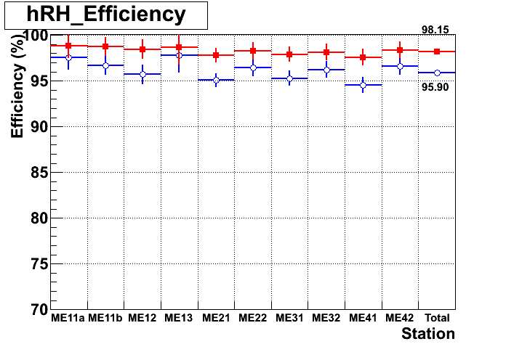
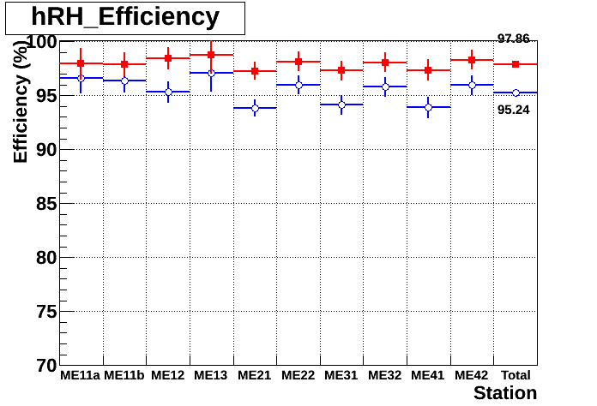
RecHit efficiency for muon segment
<number>
1000 GeV
100 GeV
blue – ST algorithm; red – RU algorithm.
10 GeV
ZMM+PU(25)

Slide 30
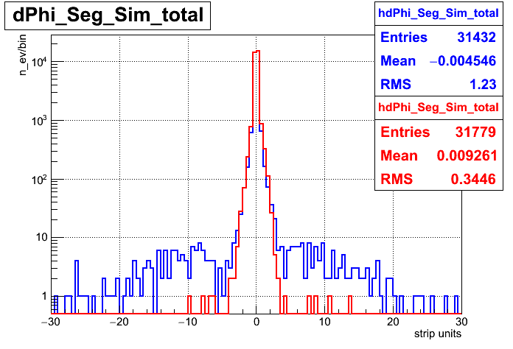
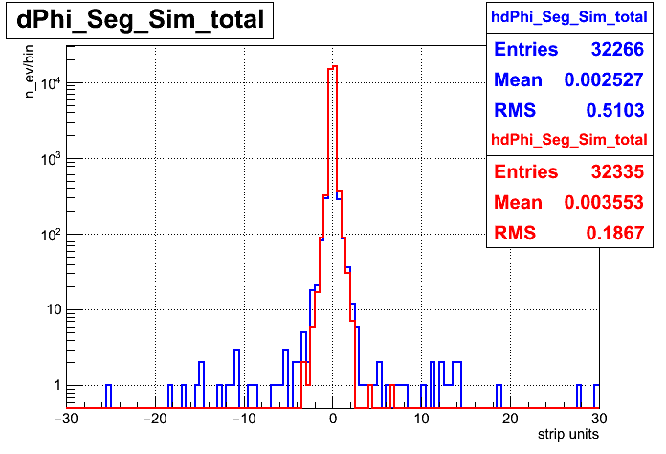
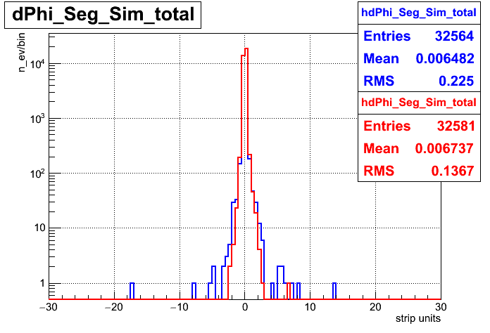
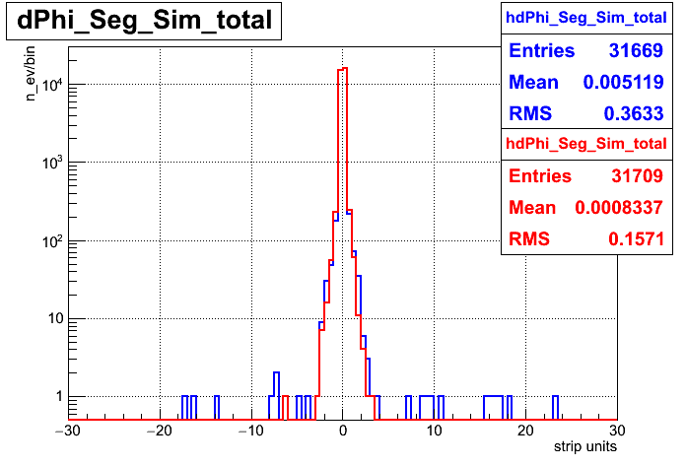
dPhi (RecoSeg - SimSeg)
<number>
1000 GeV
100 GeV
ZMM+PU(25)
10 GeV
blue – ST algorithm; red – RU algorithm.

Slide 31
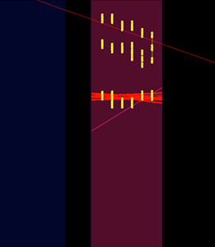
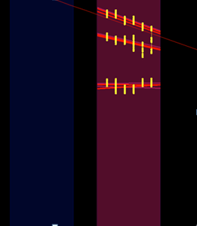
High multiplicity example - 72 RecHits in ME21
Muon trajectory
Standard
10 segments
New
11 segments
<number>
Collisions2015 256630:26:34248876

Slide 32
Event Example for R-coordinate
ST segments Goal segments
Collisions 2012 Run 198210 ME1/3 n_ev 1543
Collisions 2012 Run 198210 ME1/3 n_ev 12044
<number>

Slide 33
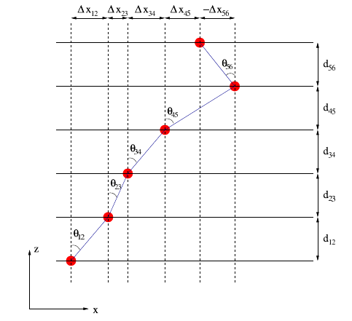
ST algo
Spanning Tree (ST)
(1)
(2)
(3)
<number>

