Slide 1
CSC Local Reconstruction Improvements Vladimir Palichik, Nikolay Voytishin JINR(Dubna)
JINR CMS Physics Meeting
December 14, 2017

Slide 2
RU CSC Segment Builder
1000 GeV

Slide 3
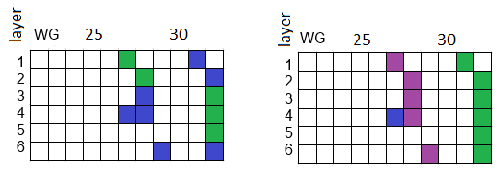
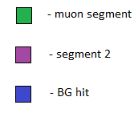
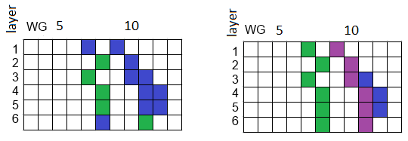
Event Example for R-coordinate
ST segments Goal segments
Collisions 2012 Run 198210 ME1/3 n_ev 1543
Collisions 2012 Run 198210 ME1/3 n_ev 12044

Slide 4
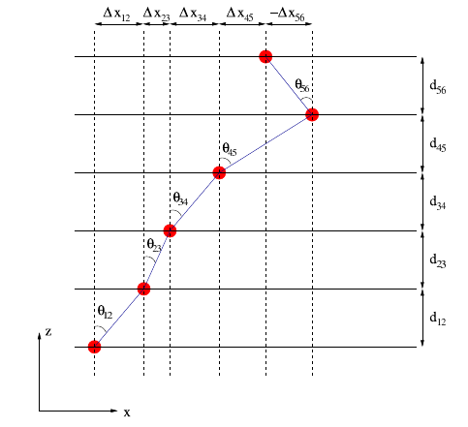
Modified ST algo
Spanning Tree (ST)
(1)
(2)
Modified Spanning Tree (newST)
While adding hits on the next layer use lower_bound and upper_bound cuts in order for the segment to point towards the interaction point.
(3)
𝑙𝑜𝑤𝑒𝑟_𝑏𝑜𝑢𝑛𝑑= 𝑞𝑊𝐺_𝑚𝑖𝑛−1.5∗max𝑊𝐺_𝑤𝑖dtℎ
𝑢𝑝𝑝𝑒𝑟_𝑏𝑜𝑢𝑛𝑑= 𝑞𝑊𝐺_𝑚𝑎𝑥+1.5∗max𝑊𝐺_𝑤𝑖𝑑𝑡ℎ

Slide 5
Segment Efficiency
Seg_efficiency = $\left\{\begin{aligned}\frac{nr of GRH in segment}{ nr of GRH in chamber}, nr of GRH in Segment≥ \frac{nr of GRH in chamber}{2} \\ 0, nr of GRH in Segment< \frac{nr of GRH in chamber}{2}\end{aligned}\right.$

Slide 6
RU(RoadUsage) Algorithm main ideas
Taking into account the IP while choosing the base hits in terms of WG for the future segment;
Base Road for RecHit association:
A straight line is traced through the base hits
In the road formed along this line new hits from the inner layers are added to the segment
Phi & $χ^{2}$ tuned thresholds for each CSC station;
Optimal point rejection for bad $χ^{2}$ segments.
min($\sum_{i}{|d_{i}|}$)

Slide 7
Additional tuning of the RU Algorithm
Increase dPhi threshold for base RecHits with big strip error;
Increase dPhi threshold for RecHits from inner layers reconstructed on the center of the strip or with big strip error;
Skip chamber with >150 RecHits;
Do not take as a base layer if there are >25 RecHits on this layer;
Build all possible same size proto-segments allowing RecHit overcrossing and choose best segments by $χ^{2}$ criteria;
If there are enough unused RecHits left the segment reconstruction is run again with the IP check turned off in order to reconstruct segments that correspond to displaced muons.

Slide 8
New algorithm promotion
A specialized validation code made for MC data analysis;
TnP analyzer modified for collisions analysis;
Multiple data analyzed:
Private MC:
Single Muon Pt10GeV;
Single Muon Pt100GeV;
Single Muon Pt1000GeV;
MC RelVals:
ZpMM;
ZMM;
ZMM+PU(25ns);
ZMM+PU(50ns);
TTBar;
Collisions data (with various cuts on muon Pt):
2012 collisions;
2015 collisions;
2016 collisions.
Displaced Muons;
Halo Muons;
JPsi;
Single Muon Pt1000GeV;
14 talks given on different meetings (CSC Weekly, MuPOG, RECO/AT) showing the comparison results and progress status of the new algorithm.

Slide 9
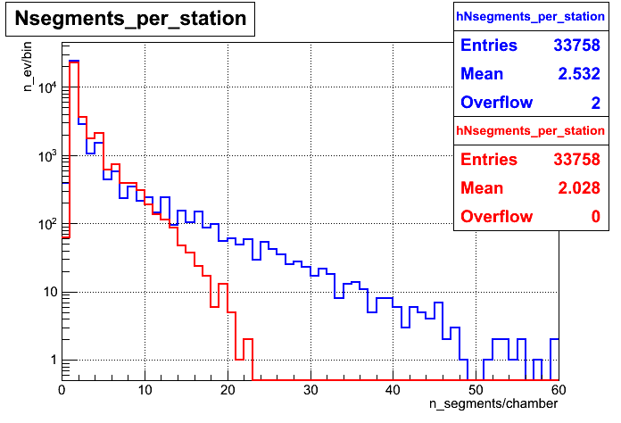
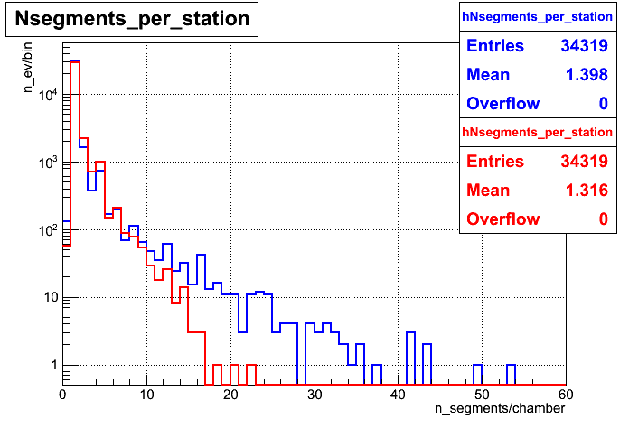
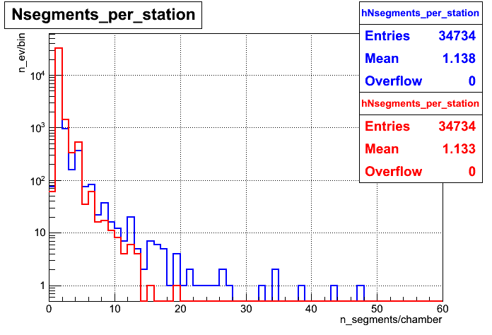
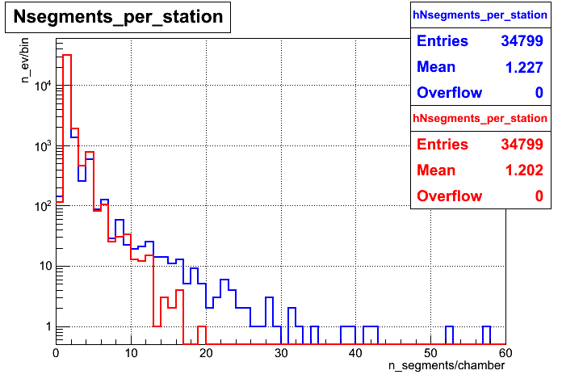
Segment multiplicity per station
1000 GeV
100 GeV
10 GeV
ZMM+PU(25ns)
blue – ST algorithm; red – RU algorithm.

Slide 10
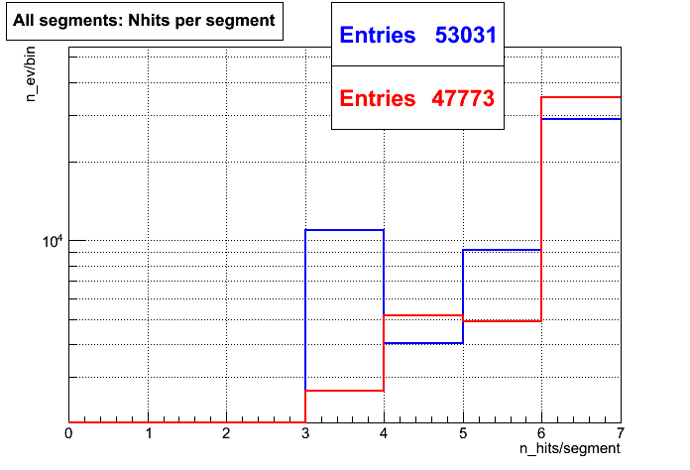
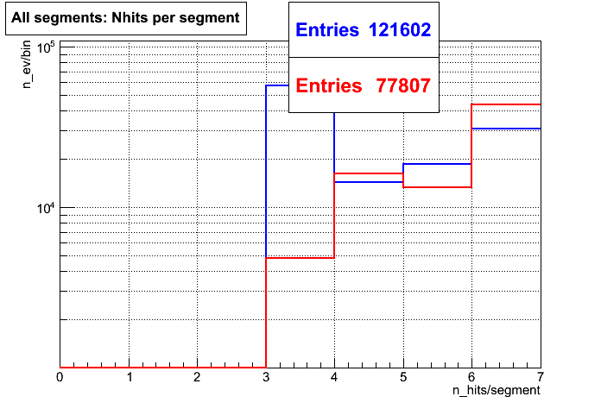
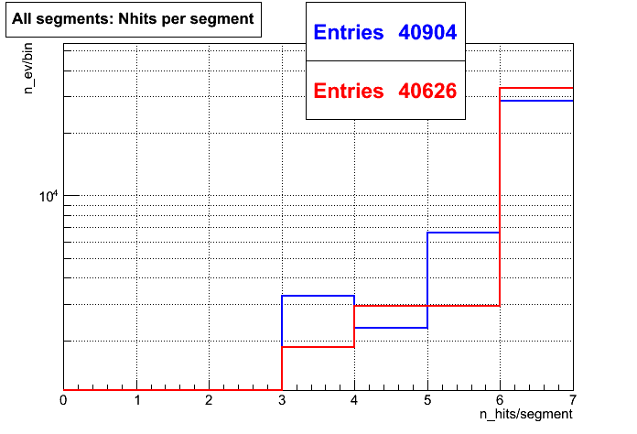
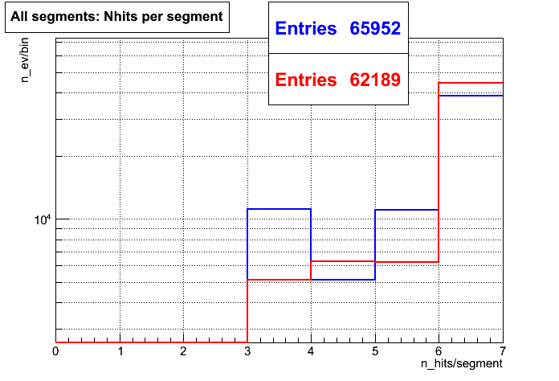
Number of RecHits in all reconstructed segments
100 GeV
1000 GeV
blue – ST algorithm; red – RU algorithm.
10 GeV
ZMM+PU(25ns)

Slide 11
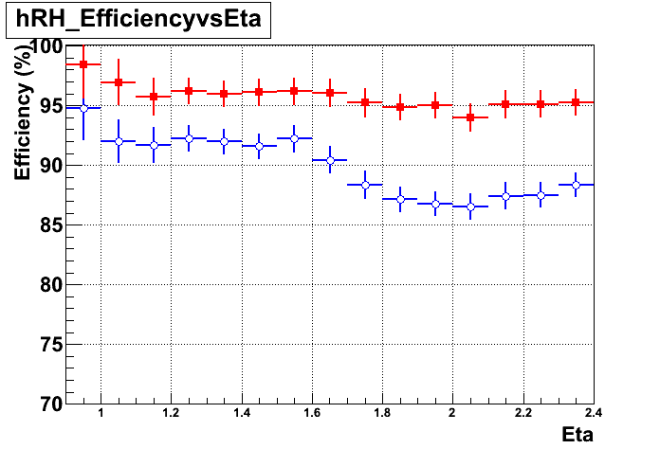
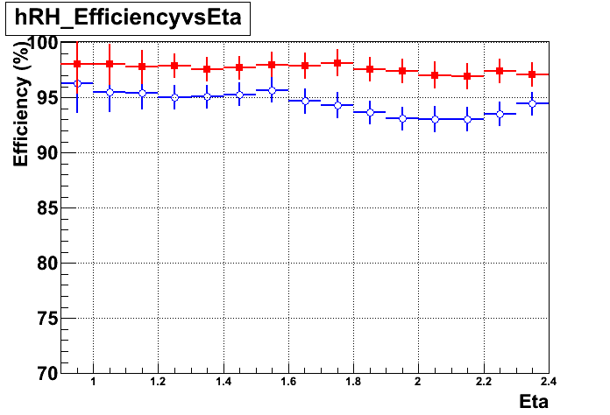
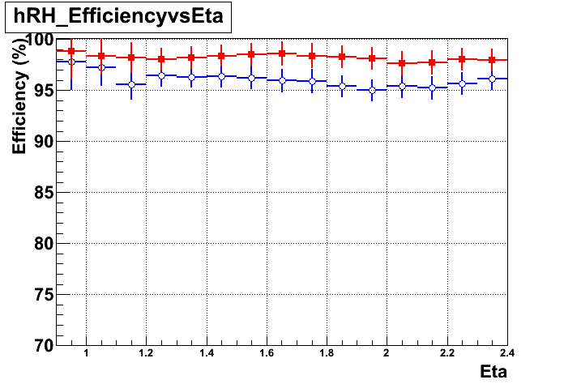
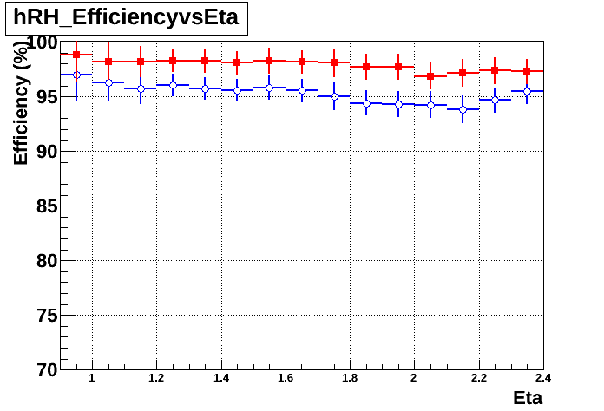
RecHit efficiency vs η for muon segment
1000 GeV
100 GeV
10 GeV
ZMM+PU(25)
blue – ST algorithm; red – NEW algorithm.

Slide 12
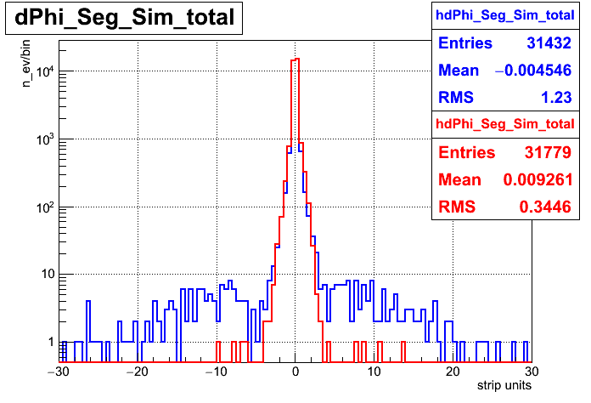
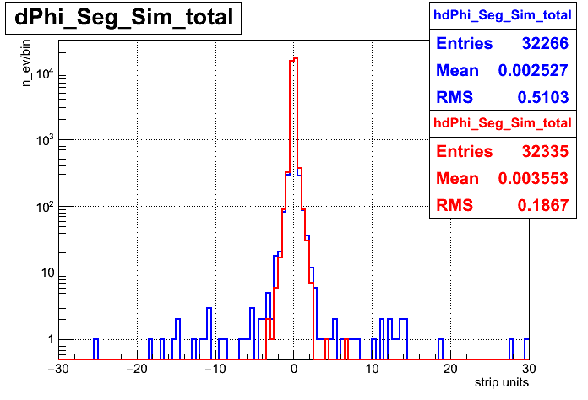
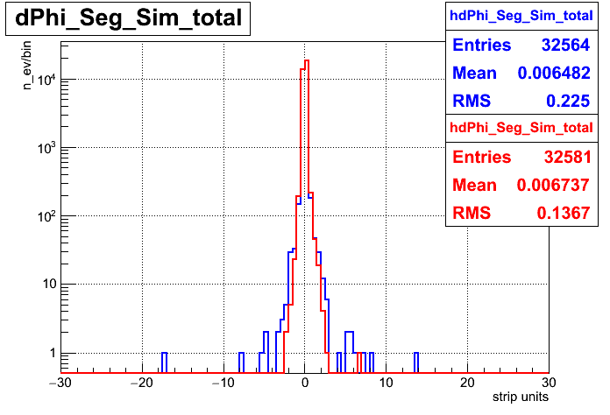
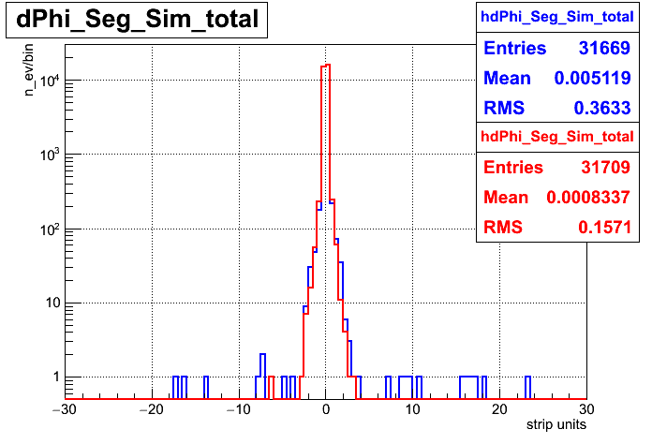
dPhi (RecoSeg - SimSeg)
1000 GeV
100 GeV
ZMM+PU(25)
10 GeV
blue – ST algorithm; red – RU algorithm.

Slide 13
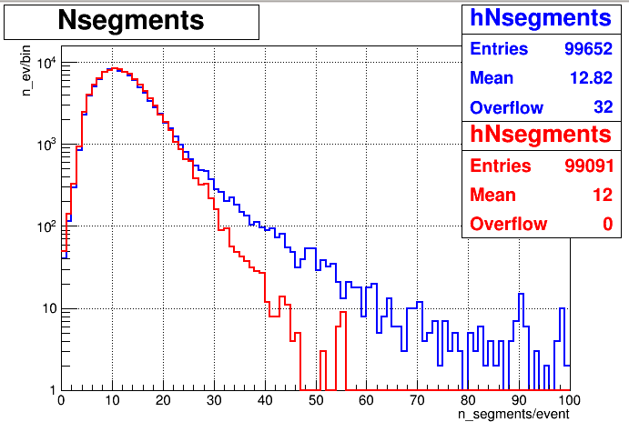
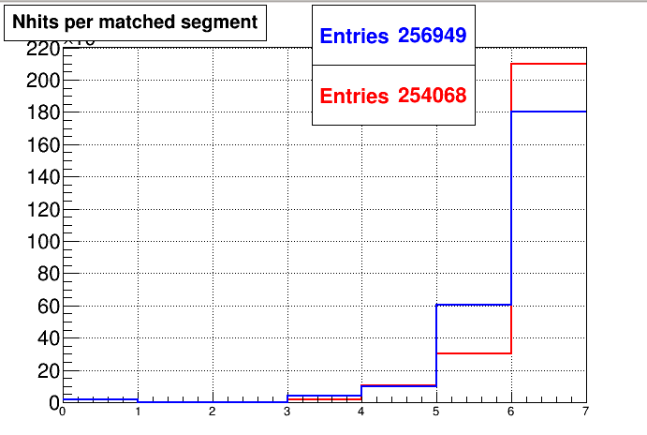
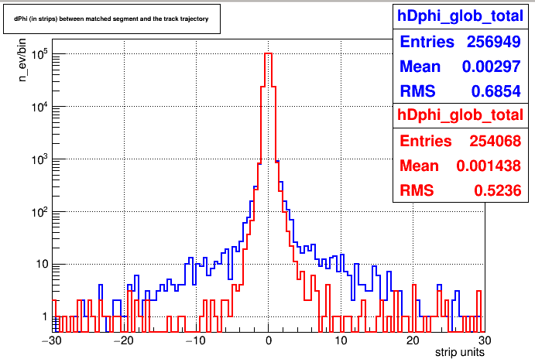
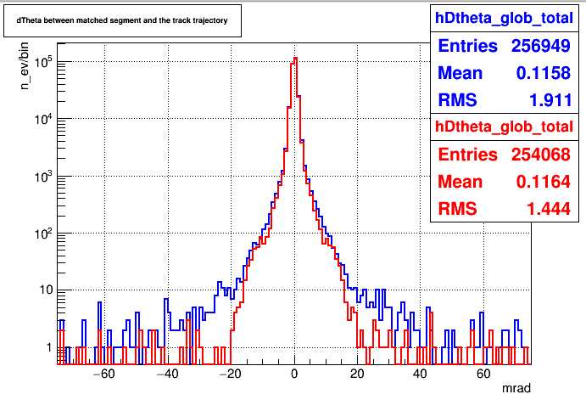
Collision data cut p>100GeV
SingleMuPt1000
100 GeV
blue – ST algorithm; red – NEW algorithm.
dPhi (Matched segment – GlobMu trajectory)
dTheta (Matched segment – GlobMu trajectory)
DisplacedMu SUSY
Halo Muons
blue – ST algorithm; red – NEW algorithm.

Slide 14
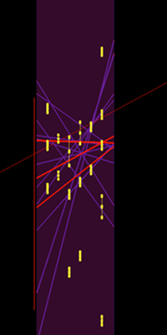
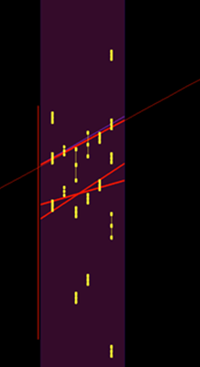
High multiplicity example - 84 RecHits in Chamber
Muon trajectory
ST
15 segments
RU
4 segments

Slide 15
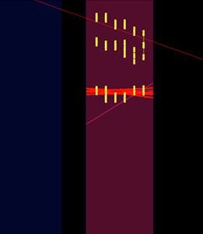
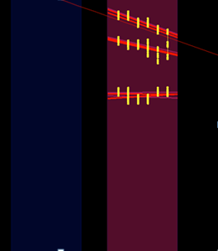
High multiplicity example - 72 RecHits in ME21
Muon trajectory
Standard
10 segments
New
11 segments
Collisions2015 256630:26:34248876

Slide 16
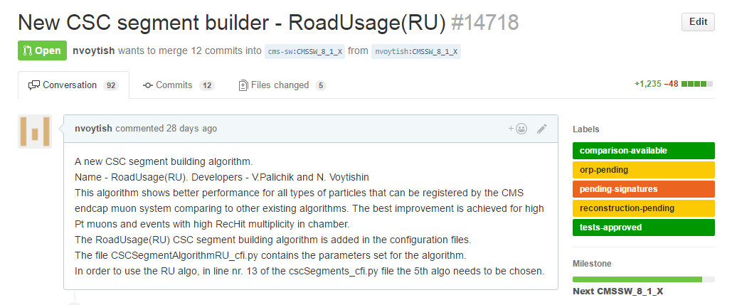
Pull Request submitted
https://github.com/cms-sw/cmssw/pull/14718 - June 20, 2016
After RECO conveners reviewed the code some modification and optimization to the code done;
PR got approved and RU builder became the 5th optional algorithm starting with Summer 2016;
Starting with 2017 data RU segment builder became the default builder for data and simulation reconstruction.

Slide 17
Further issues
Minor bugs found by Marcello Maggi while adopting the RU segment builder for ME0 reconstruction – fixed;
Some improvement of the algorithm done – included in the update along with the fix from the previous bullet;
Multithreading issue due to improper initialization of some parameters (in progress), but a temporary fix already applied by Slava Krutelyov;

Slide 18
RU algo used for GEM detectors in CMS
Reported by R. Venditti On Behalf of the CMS GEM Reco&Val group

Slide 19
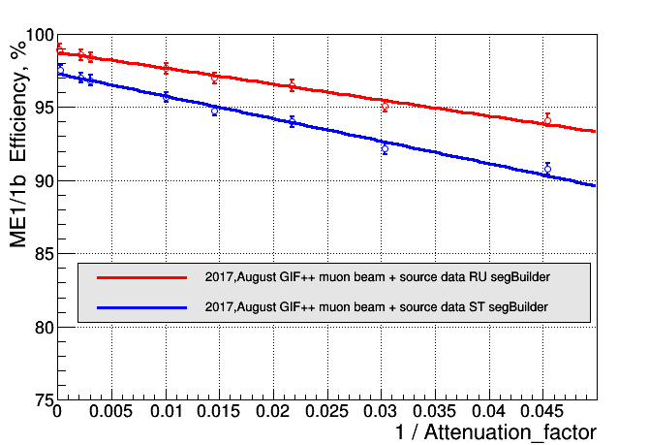
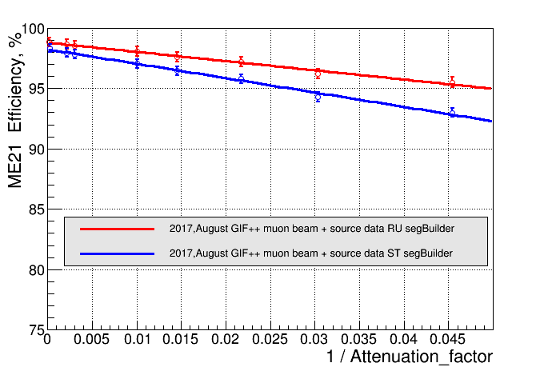
RH efficiency vs. attenuation factor with GIF++ data
RU algorithm in HL-LHC conditions
I ~ < I (HL-LHC) >
I ~ < I (HL-LHC) >
blue – ST algorithm; red – RU algorithm.

Slide 20
Summary I
The new algorithm shows a better performance for all types of CMS data;
The optimization and bug elimination is continuously ongoing;
The RU algorithm was implemented in the official CMS software starting with CMSSW_8_1_0 (July, 2017);
The RU algorithm most probably will be used for segment reconstruction in the new GEM detectors of the CMS muon system;
The RU algorithm became the default segment reconstruction algorithm starting with CMSSW_9_X_X for Monte-Carlo production and experimental data reconstruction after the restart of LHC;
Using GIF++ data we showed that the new algorithm is less sensitive to HL-LHC conditions than the ST algorithm.

Slide 21
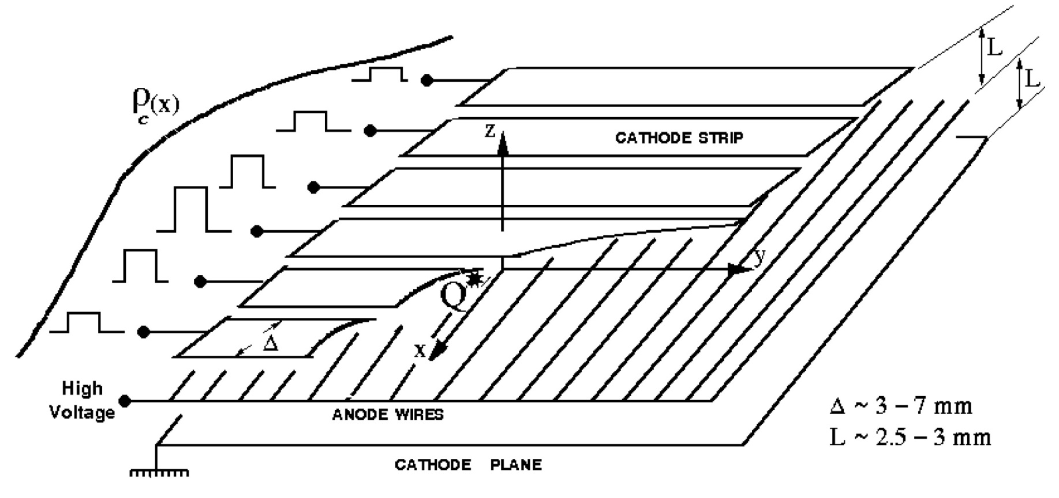
CSC RecHit Reconstruction Improvement

Slide 22
Why the improvement is needed ?
Additional options added to RU segment builder for handling “bad” RecHits (see talk [1]):
Increase dPhi threshold for base RecHits with big strip error;
Increase dPhi threshold for RecHits from inner layers reconstructed on the center of the strip or with big strip error;
Muon trajectory
Big strip error RHs
$σ_{strip(RH)}$ > 30% of strip width
$σ_{Gatti_fit}$ ~ 2% of strip width
Regular strip charge distribution
Abnormal strip charge distributions
Collisions 2015 event display
[1] https://indico.cern.ch/event/388966/contributions/922281/attachments/777650/1066373/15_04_22-Voytishin_Palichik-CSCSegBuilder_fixed_sumw.pdf

Slide 23
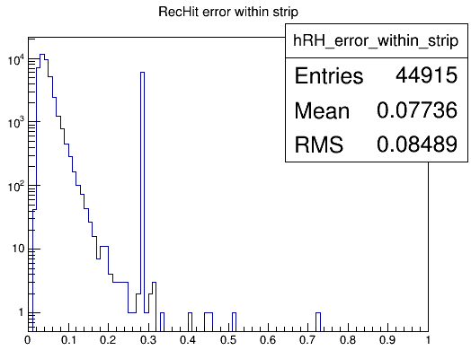
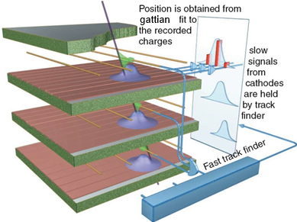
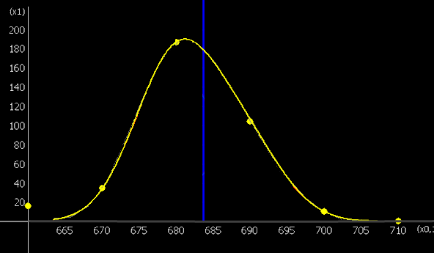
When the improvement is needed ?
reconstructed coordinate
If $σ_{strip(RH)}$ > $\frac{1}{4} of strip width$ =>
the coordinate is calculated using Center of Gravity (CoG) like algorithm
Charge on strips
Strip_nr*10

Slide 24
Introduction to wavelet analysis
The g2-WTS(Wavelet-TranSform method based on the usage of second degree wavelets ($g_{2}$))[1] was chosen by us for overlapping signal recognition.
The main function in wavelet analysis is the following double gaussian function
$G\left(x;A,x_{1};B,x_{2}\right)=Aexp(−\frac{{\left(x−x_{1}\right)}^{2}}{2σ^{2}})+Bexp(−\frac{{\left(x−x_{2}\right)}^{2}}{2σ^{2}})$ (1)
While processing the signal it is divided in a set {$h_{k}$}, where
$h_{k}$ = $\frac{1}{τ}$ $\int_{x_{k−1}}^{x_{k}}{G\left(x;A,x_{1};B,x_{2}\right)dx}$ (2)
Gauss wavelets W for the function G can be represented as follows:
$Wg_{n}\left(a,b\right)G=A{wg}_{n}\left(\frac{b−x_{1}}{s}\right)+B{wg}_{n}\left(\frac{b−x_{2}}{s}\right),$ (3)
where
$w=\left(\frac{σa^{n+\frac{1}{2}}}{\sqrt{\left(n−1\right)!} s^{n+1}}\right)$
Here b is the shift, a is the scale and $s=\sqrt{a^{2}+σ^{2}}$, $g_{n}$– gaussian wavelet of the n-th degree, h- cluster of strip charges,$σ$- half-width of the wavelet.
To find the n-th wavelet coefficients of the set h we use:
$W_{n}\left(a,b\right)h=\frac{s^{n+1}}{\sqrt{2π}σa^{n+1}} \sum_{k=1}^{N}{{(h}_{k}\int_{x_{k−1}}^{x_{k}}{g_{n}\left(\frac{x−b}{a}\right)dx}})$ (4)
G.Ososkov, A.Shitov Gaussian Wavelet Features and Their Applications for Analysis of Discretized Signals // Comp.Phys.Comm, v.126/1-2, 149-157, (2000)

Slide 25
Our case
We build 2, 3 or 4 gaussians on a chosen interval of strips with a constant step. For the case of three overlapped signals the formula (1) looks as follows:
$G\left(x,A_{1},x_{1},A_{2},x_{2},A_{3},x_{3}\right)=A_{1}e^{−\frac{{(x − x_{1})}^{2}}{2σ_{1}^{2} }}+A_{2}e^{−\frac{{(x − x_{2})}^{2}}{2σ_{2}^{2} }}+A_{3}e^{−\frac{{(x − x_{3})}^{2}}{2σ_{3}^{2} }}$.
The parameters $A_{1},x_{1},A_{2},x_{2},A_{3},x_{3}, σ_{1},σ_{2},σ_{3}$of the overlapped signals are obtained by summation of the values of these gaussians in each coordinate x.

Slide 26
What has been done ?
Time Bins
Input data – ADCs on strips
Visualization of the input data
ADCs
Strip_nr
ADCs
Search area selection
Result display
Strip_nr
Strip_nr*10
Universal tool for overlapping signal recognition

Slide 27
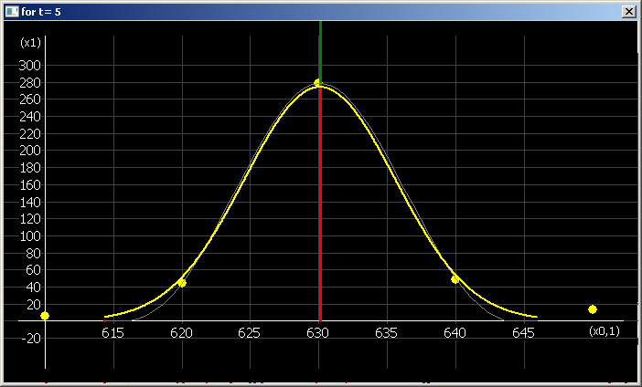
Good case example
ADCs
NO need for improvement
$$MC Pt1000GeV event$$
$σ_{Gatti_fit}$ ~ 2% of strip width
Strip_nr*10
The coordinate is well reconstructed by both methods (all coord’s coincide):
Yellow line – initial charge distribution;
Green line – simulated muon coordinate;
Red line – wavelet analysis;
Blue line – standard approach (Gatti fit).

Slide 28
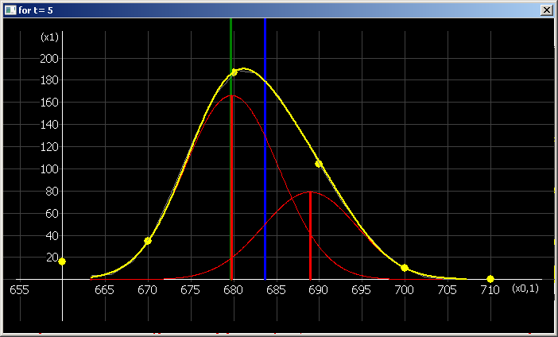
Two overlapped signals recognition
ADCs
$$MC Pt1000GeV event$$
$σ_{Strip(RH)}$ > 25% of strip width
Strip_nr*10
Yellow line – initial charge distribution;
Green line – simulated muon coordinate;
Red line – wavelet analysis;
Blue line – standard approach (CoG like).

Slide 29
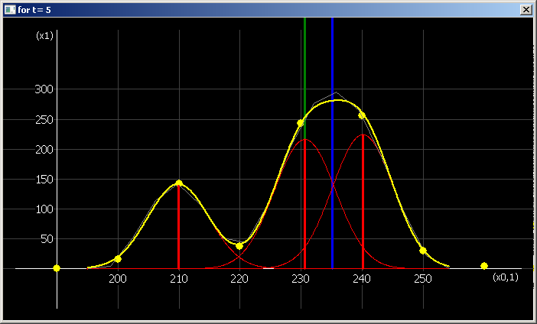
Three overlapped signals recognition
ADCs
$$MC Pt1000GeV event$$
$σ_{strip(RH)}$ > 25% of strip width
Strip_nr*10
Yellow line – initial charge distribution;
Green line – simulated muon coordinate;
Red line – wavelet analysis;
Blue line – standard approach (CoG like).

Slide 30
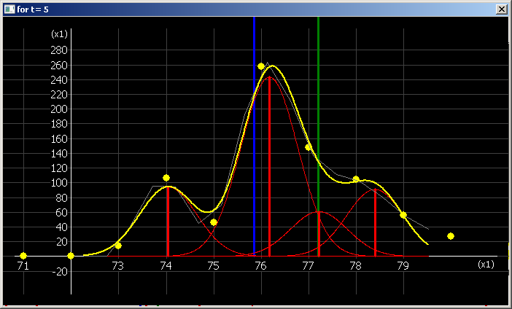
Four overlapped signals recognition
ADCs
$$MC Pt1000GeV event$$
$σ_{strip(RH)}$ > 25% of strip width
Strip_nr*10
Yellow line – initial charge distribution;
Green line – simulated muon coordinate;
Red line – wavelet analysis;
Blue line – standard approach (CoG like).

Slide 31
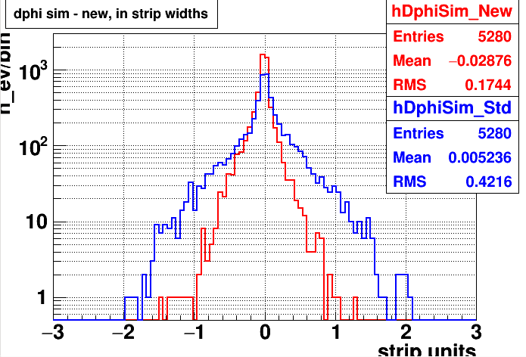
dPhi (sim- reco)
Preliminary results
On MC Pt1000GeV

Slide 32
Summary and plans
The development of the new RecHit reconstruction algorithm is ongoing;
The new approach reconstructs the strip coordinate ~2.5 times closer to the MC muon in comparison with the standard approach;
The optimization of the algorithm needs to be done:
Time consumption;
Number of overlapped signals to search selection;
Initial parameters approximation.
Implementation into CMSSW and testing on various datasets;
Two-track resolution estimation for the new approach.

Slide 33
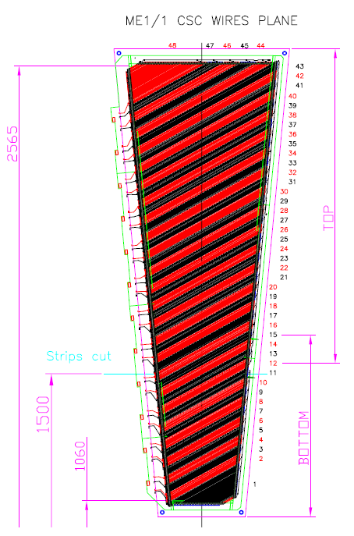
ME11 a/b transition region

Slide 34
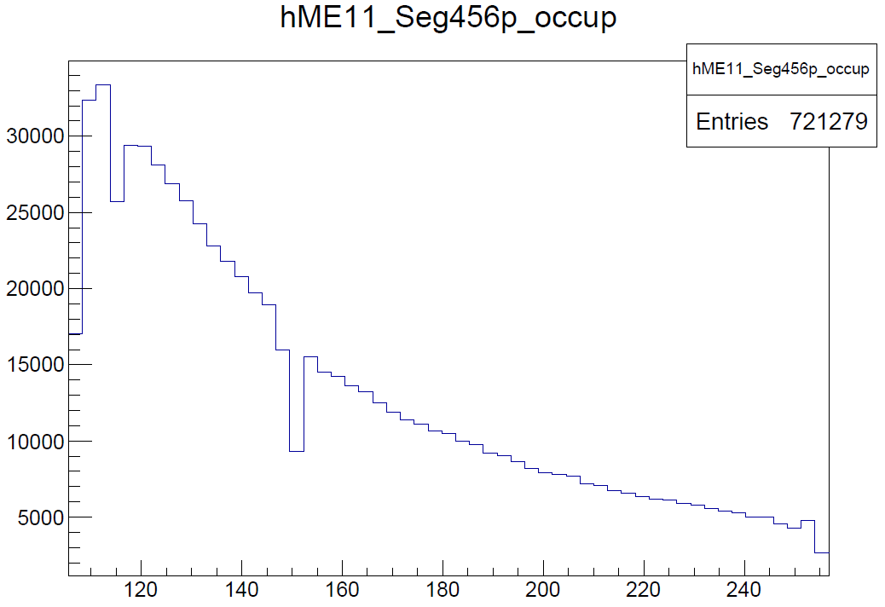
ME11a/b transition region
Segment occupancy vs. radius
R(cm)

Slide 35
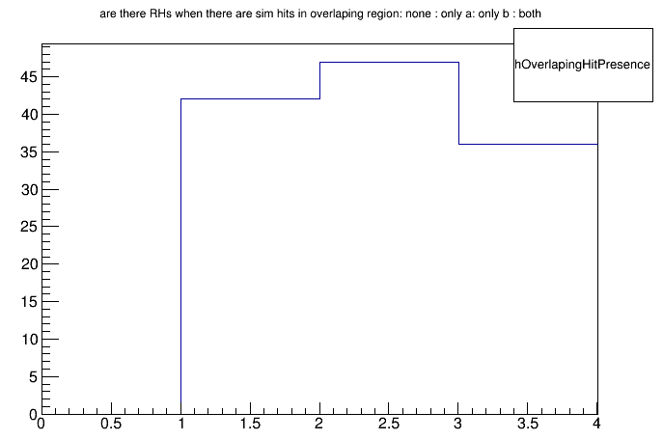
Solutions
MC SingleMuPt1000GeV data
No RHs in ME11a/b
RHs only in ME11a
RHs only in ME11b
RHs in ME11 a & b
Segment occupancy vs. radius
~10% increase
R(cm)
Solution : Pass the combined ME11 a + b RecHit collection to the segment builder instead of two separate collections.
Need to look into trigger objects to understand bins № 2 & 3

Slide 36
Thank you for your attention!

Slide 37
Back up slides

Slide 38
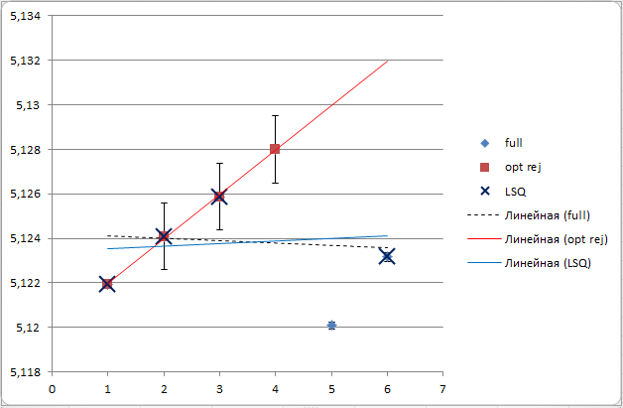
Optimal point rejection vs. LSQ 6p->4p
$χ^{2}$_6p_seg = 273;
$χ^{2}$_LSQ_seg = 175;
$χ^{2}$_optimal_point_rej_seg = 0.002;

Slide 39
Optimal point rejection vs. LSQ 6p->5p
$χ^{2}$_6p_seg = 235;
$χ^{2}$_LSQ_seg = 121 ;
$χ^{2}$_optimal_point_rej_seg = 54;

Slide 40
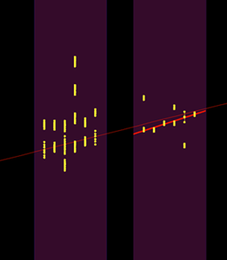
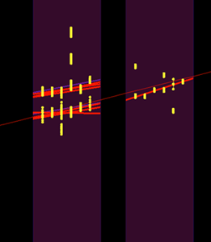
High multiplicity example - 44 RecHits in ME21
Muon trajectory
Standard
0 segments
New
8 segments
Collisions2015 256630:22:28500814

Slide 41
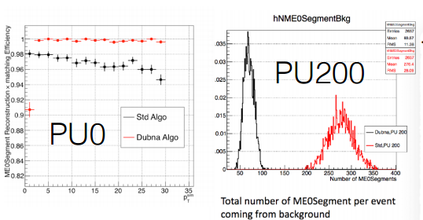
https://indico.cern.ch/event/611558/contributions/2465877/ talk by Cesare Calabria, 17-02-06 MuPOG Meeting

