Slide 1
ATLAS DQ2 Deletion Service
D.A. Oleynik, A.S. Petrosyan, V. Garonne, S. Campana
(on behalf of the ATLAS Collaboration)

Slide 2
ATLAS DDM
The ATLAS Distributed Data Management(DDM) project is charged with managing ATLAS data on heterogeneous distributed resources
DDM has to:
Catalog data
Transfer data to/from sites
Delete data from sites
Ensure data consistency at sites
Enforce ATLAS computing model requirements
Don Quijote 2(DQ2) is the current implementation
GRID2012, Dubna, 16-21 July
<number>

Slide 3
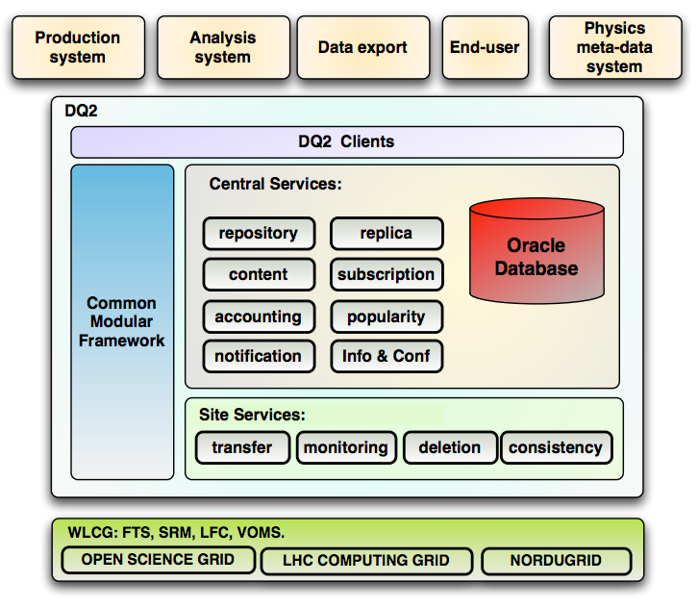
DDM DQ2
100 petabytes of data
300 million ﬁle replicas
800 active users
130 sites
1.5 million files uploaded each day
3.7 million files downloaded each day
2 to 7 million files deleted each day
25 million hits per day
100,000 wildcard searches per day
GRID2012, Dubna, 16-21 July
<number>

Slide 4
DQ2 Deletion Service
ATLAS DQ2 Deletion service serves deletion requests on the grid by interacting with grid middleware and the DQ2 catalogues.
Furthermore, it also takes care of retry strategies, check-pointing transactions, load management and fault tolerance.
GRID2012, Dubna, 16-21 July
<number>

Slide 5
DQ2 Deletion Service. System architecture
Server: collects deletion requests, stores detailed information about datasets, their contents (files) and the ongoing state of deletion requests.
Client: provides communication between the server and other components of the service.
Deletion Agent: performs actual deletion through intercommunication with the LFC servers and the storage system.
GRID2012, Dubna, 16-21 July
<number>

Slide 6
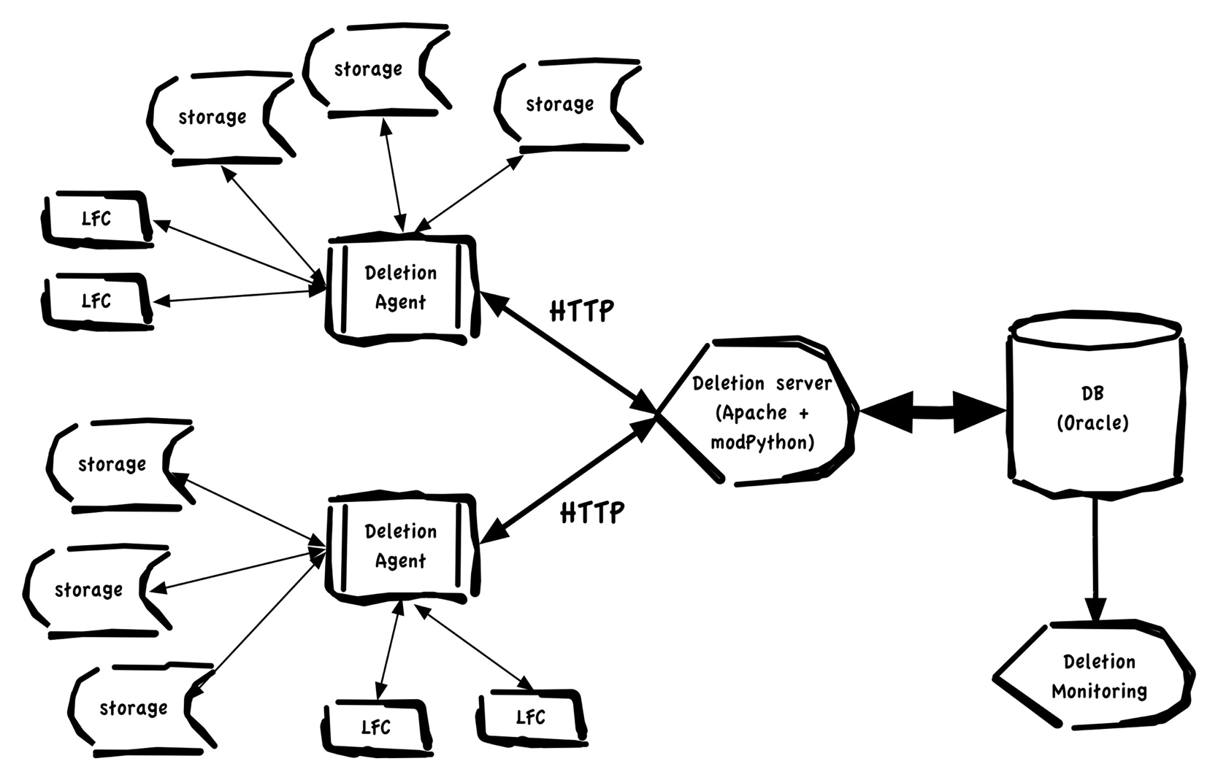
DQ2 Deletion Service. System architecture
GRID2012, Dubna, 16-21 July
<number>

Slide 7
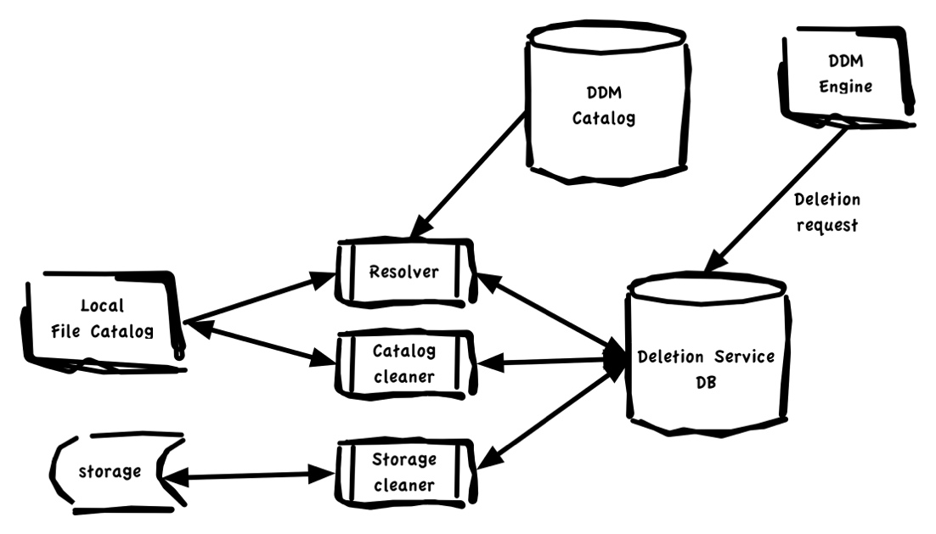
Deletion Agent
Resolve list of files for deletion on site (overlapped datasets)
Unregister files from LFC catalog
Delete files from mass storage systems.
Deletion agent works as three independent (parallel) processes: resolver, catalog cleaner, storage cleaner.
GRID2012, Dubna, 16-21 July
<number>

Slide 8
DQ2 Deletion Service. DB backend
Oracle based database:
‘File level’ check pointing of deletion operations
DB schema split for ‘operation’ and ‘log’ part
Full log of deletion operations for each file
Log table updated by triggers
Dataset deletion logic based on triggers
DB schema integrated with DQ2
Intercommunications by oracle jobs
GRID2012, Dubna, 16-21 July
<number>

Slide 9
DQ2 Deletion Service. Features
Productivity:
Deletion Agent is designed as multithread application. Each site served own copy of resolver, catalog and storage cleaner.
Bulk operations: size of chunks configurable for sites and endpoints .
Load throttling:
Configurable delays between operations on site and endpoint level
‘Grace period’
GRID2012, Dubna, 16-21 July
<number>

Slide 10
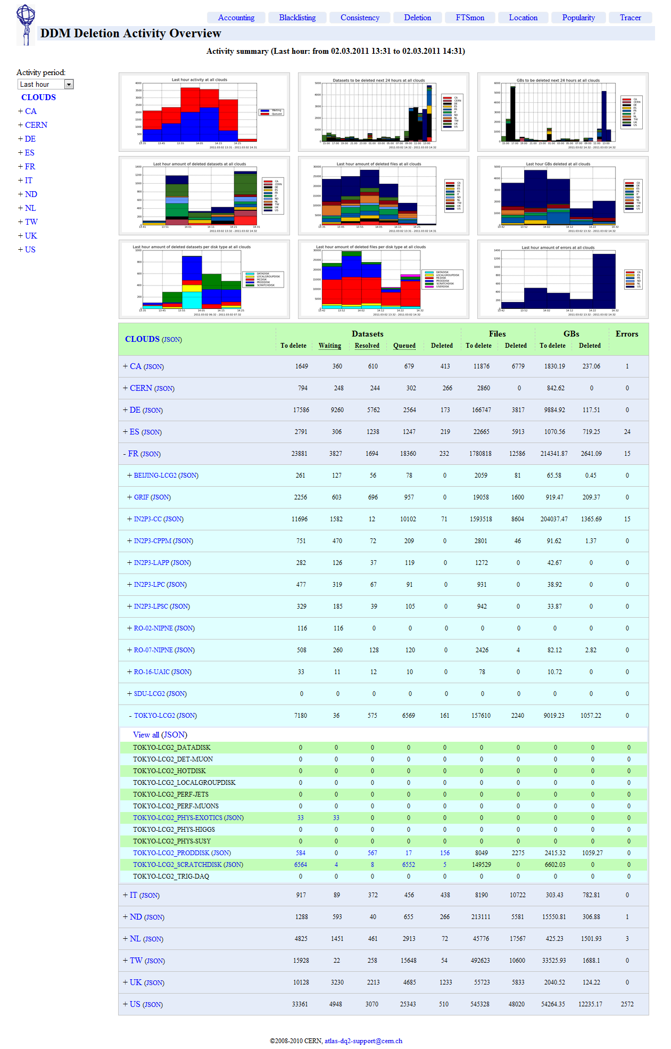
Deletion Monitoring
Web application based on the Django framework, provides live graphical and statistical reports about deletion process.
The information is available at the cloud/site/endpoint levels.
jQuery AJAX calls: reduce and simplify requests to DB
BBQ plug-in: maintain history and bookmarks
http://bourricot.cern.ch/dq2/deletion/
GRID2012, Dubna, 16-21 July
<number>

Slide 11
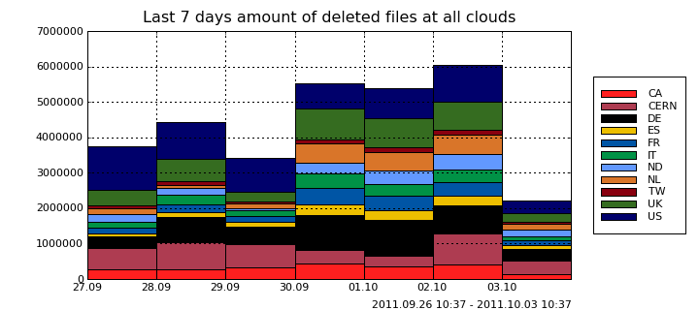
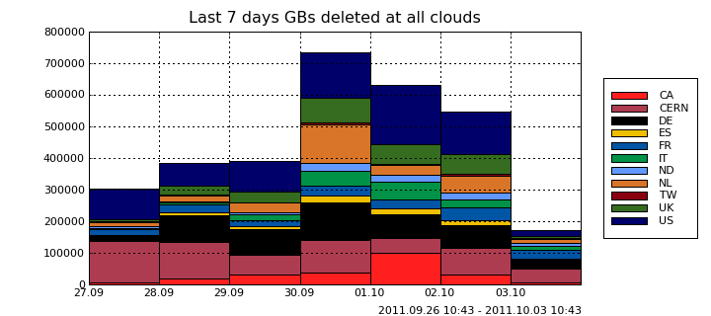
Statistic
GRID2012, Dubna, 16-21 July
<number>

Slide 12
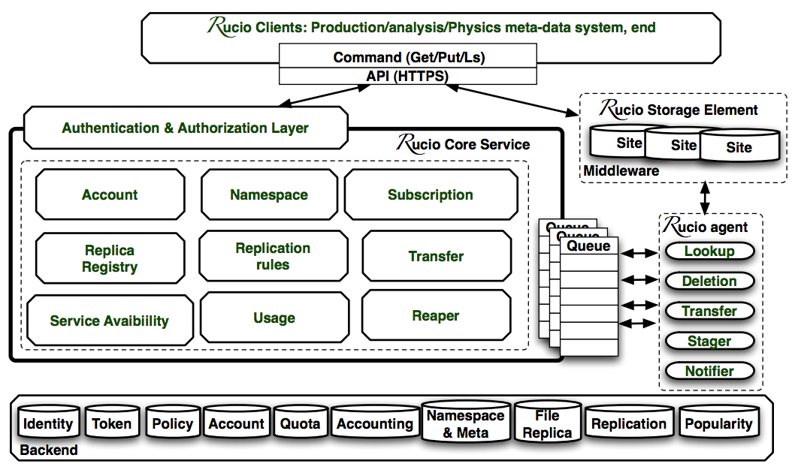
DDM future: Rucio
Rucio – next version of Distributed Data Management
GRID2012, Dubna, 16-21 July
<number>

Slide 13
Rucio Deletion agent
At least these changes should be implemented:
Resolver: implementation should be changed in part of overlapping datasets processing
Catalog cleaner will not be needed: LFC intercommunications on database level, since one (CERN) LFC for all sites
Storage cleaner: SRM less storage access.
Works for new implementation of Deletion agent scheduled on autumn 2012
GRID2012, Dubna, 16-21 July
<number>

Slide 14
Deletion monitoring. Future
New processing of deletion statistical data will be in production in nearest future, but visualization part (web ui) should be changed accordingly.
GRID2012, Dubna, 16-21 July
<number>

